Slide 1
Recursion
AI2C Techs

Slide 2
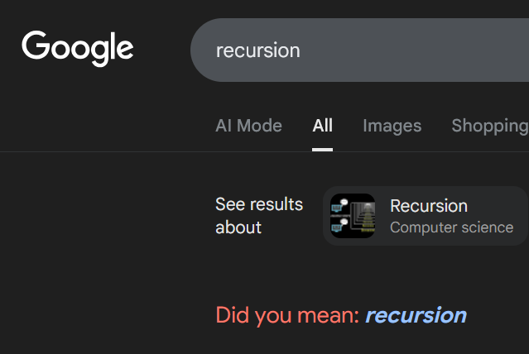
What is recursion?
To understand recursion, you must understand recursion
An algorithm that uses itself in its definition
“pip installs packages”
Two requirements:
A base case
A recursive step
Notes:
“Recursion is a function that calls itself” – Maj Shafer
Purposely writing a infinite loop, but you need a way to break out of the loop
Maximum recurse is 1,000 returns in python

Slide 3
Terms
Base case:
The “terminating step”
How does the recursion stop?
Recursive step
Decreases the size of the input
Passes smaller input to a new instance of itself

Slide 4
An example
What is(are) the base case(s)?
What is(are) the recursive step(s)?
The input datatype doesn’t change
Small demo
def factorial(n: int):
if n == 1 or n == 0:
return 1
return n * factorial(n - 1)
Notes:
Factorial function:
7! = 7 * 6 * 5 * 4 * 3 * 2 * 1

Slide 5
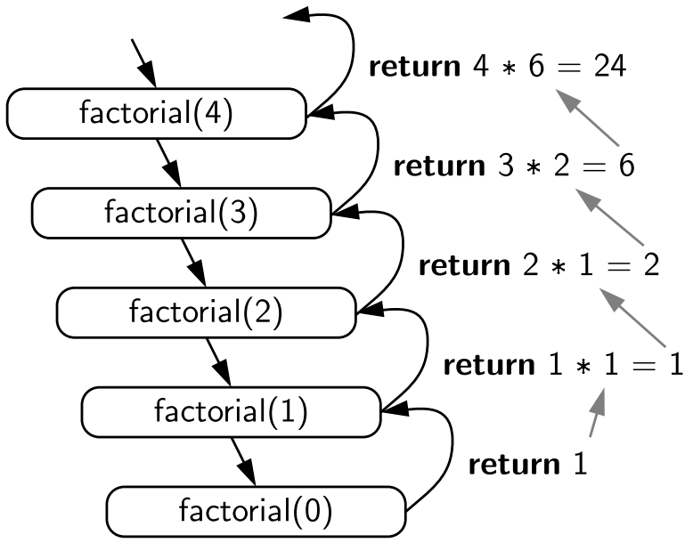
Order of Execution / Return Values

Slide 6
More Examples
Palindrome checker
String to int
Notes:
Instructor demo
Palindrome = a word that you can reverse the letters and the word wouldn’t change. Ex: Level, Peep, Racecar

Slide 7
On Your Own
Calculate the sum of a list of numbers using recursion
What is(are) the base case(s)?
What is(are) the recursive step(s)?
(be careful about passing lists around)

Slide 8
A solution
def re_sum_one(num_list: list[int]) -> int:
if len(num_list) == 1:
return num_list.pop()
last = num_list.pop()
print(f"Calculating {num_list[:]} + {last}")
return re_sum_one(num_list[:]) + last

Slide 9
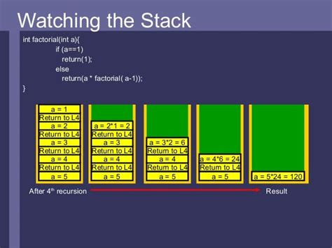
More about stacks
What bad things can happen here?
Don’t forget the base case!
Small demo

Slide 10
Multiple Recursion

Slide 11
Multiple Recursion
A function that calls itself multiple times
What is(are) the base case(s)?
What is(are) the recursive step(s)?
def fib(n: int) -> int:
if n == 0:
return 0
if n == 1:
return 1
return fib(n-1) + fib(n-2)
Notes:
Two base cases ‘if n == 0’ and ‘if n == 1’
Recursive step: Calling fib two separate times

Slide 12
Another Example
def re_sum_half(num_list: list[int]) -> int:
if len(num_list) == 1:
return num_list[0]
half = len(num_list) // 2
return re_sum_half(num_list[:half]) + re_sum_half(num_list[half:])

Slide 13
More Examples
Max value of array
Grid path counter

Slide 14
On Your Own
Calculate the sum of a list of numbers using recursion
What is(are) the base case(s)?
What is(are) the recursive step(s)?
(be careful about passing lists around)

Slide 15
Other Common Problems

Slide 16
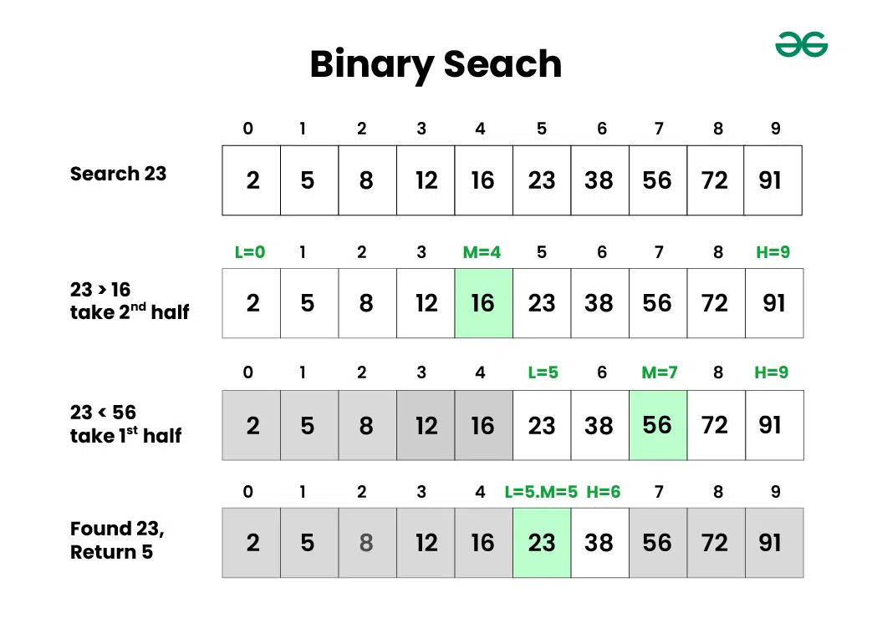
Binary Search

Slide 17
Binary Search
def binary_search(arr, low, high, x):
"""assumes array is already sorted"""
if high >= low:
mid = (high + low) // 2
if arr[mid] == x:
return mid
elif arr[mid] > x:
return binary_search(arr, low, mid - 1, x)
else:
return binary_search(arr, mid + 1, high, x)
else:
return -1

Slide 18
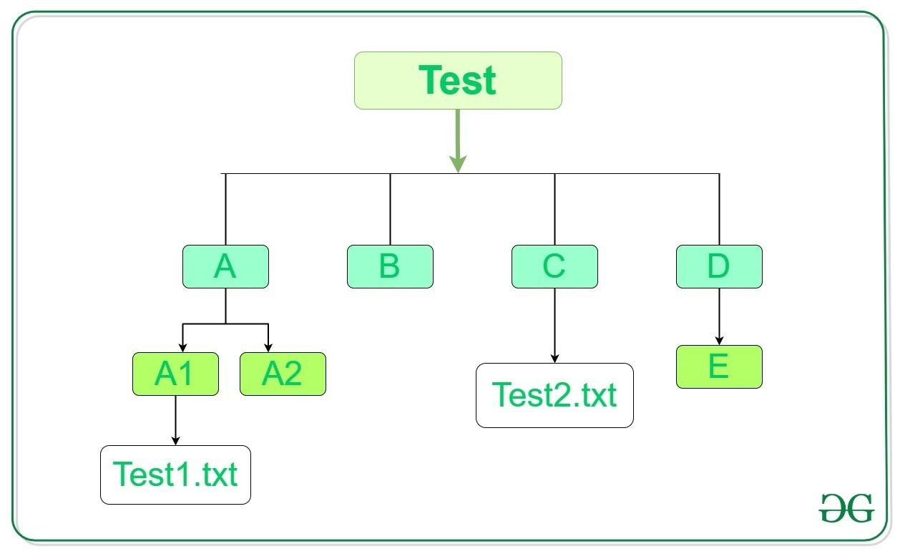
Directory Traversal

Slide 19
Directory Traversal
import os
def list_dir_recursive(directory):
for entry in os.listdir(directory):
full_path = os.path.join(directory, entry)
if os.path.isdir(full_path):
list_dir_recursive(full_path)
else:
print(full_path)

Slide 20
Other Thoughts / On Your Own
Order of Execution (depth vs breadth)
Recursive vs Iterative

Slide 21
Questions

